Slide 1

Lecture 2
Graph Preliminary

Slide 2
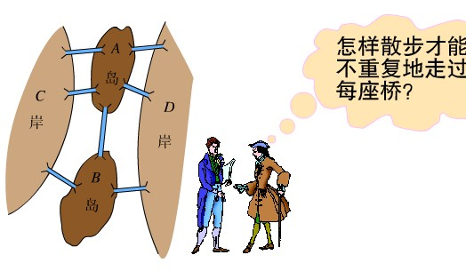

Graph Preliminary Knowledge
The origination of graph
(Maybe the first graph!) 哥尼斯堡七桥问题.

Slide 3
Graph Basics (Undirected)
A Graph G is a pair (V, E), where V is a finite set of objects and E is a set of pairs on V
  Denoted as G = (V, E)
  Element of V: vertex; V: vertex set
  Element of E: edge(arc); E: edge set
Undirected Graph : each pair in E is unordered, i.e., if (u, v) ∈E, then (u, v) = (v, u).
Undirected graph: G₁ = (V={1, 2, 3}, E={(1, 2), (2, 3), (3,1)})
or G₁ = (V={1, 2, 3}, E={(2, 1), (3, 2), (1,3)})
1
2
3

Slide 4
Graph Basics (Directed)
Directed Graph: each pair in E is ordered, i.e., for each pair of vertices, u, v, <u, v> ∈ E does not necessarily mean <v, u> ∈ E, and vice versa.
Directed graph: G₂ = (V={1, 2, 3}, E={<1, 2>, <2, 3>, <3,1>})
1
2
3

Slide 5
Schematic Representation
e₆
e₆
v₁
e₁
e₁
v₂
v₅
v₁
v₂
v₅
e₂
e₃
e₇
e₂
e₃
e₇
e₄
v₄
e₄
v₃
v₆
v₃
v₄
v₆
e₅
e₅
Can you give the representation in format G = (V, E) for above graphs?

Slide 6
Graph Basics (Adjacency)
Adjacency: In a graph G = (V, E), if (u, v) ∈ E, we say that vertex v is adjacent to vertex u.
  If G is an undirected graph, vertex u is adjacent to vertex v, too. The adjacency relation is symmetric.
  We also say (u , v) is incident with u and v, vice versa.
  If G is a directed graph and if <u, v> ∈ E, vertex v is adjacent to vertex u. Now, <u, v> is from (or leaves) vertex u to (or enters) vertex v.

Slide 7
Graph Basics(Multiple, Simple)
Repeated edges: edges e and f have the same endpoints.
Self-loop: an edge from a vertex to itself.
Simple graph: a graph without repeated edges and without self-loops.
Weighted graph: each edge e has a weight w(e), w(e)∈R.

Slide 8
Graph Basics (Degree)
Degree of a vertex v:
  For undirected graph:
    Number of edges incident with v.(Self-loop?)
    Denote as d_{G}(v) or simply, d(v).
  For directed graph:
    In-degree: number of edges entering (or incident to) v.
    Out-degree: number of edges leaving (or incident from) v.
    Denote as id_{G}(v), od_{G}(v) or simply, id(v), od(v) respectively.
Isolated vertex: a vertex whose degree is 0.

Slide 9
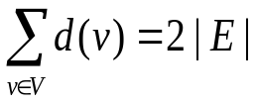
Graph Properties
Theorem 1.1 (Handshaking Lemma)
  Given an undirected graph G = (V, E), , where | E | is the number of edges in G.
  Proof: can you give?
  How about a directed graph? (sum of in-degrees equals to sum of out-degrees, i.e., the number or arcs)
Corollary 1.2
  Given an undirected graph G = (V, E), the number of vertices with odd degrees is even.
  Proof: can you give?

Slide 10
Graph Basics (Cycle)
A path is a sequence of vertices p = <v₀, v₁, v₂, …, v_{k}> such that (v_{i},v_{i+1}) ∈E, i=0,1,…,k-1.
  路径: v₀, v₁, …, v_{k} are distinct (except that v₀ = v_{k}).
  通路: otherwise
A cycle is a path c = <v₀, v₁, v₂, …, v_{k}> with v₀ = v_{k}.
  圈和回路.
  For undirected graph, a cycle contains at least 3 edges, that is, k ≥ 3 and v₁, v₂, …, v_{k} are distinct.
  For directed graph, a cycle contains at least 2 edge.
  A self-loop is a cycle of length 1.
Acyclic graph: a graph with no cycles.

Slide 11
Graph Basics (Sub-graph)
A graph G’ = (V’, E’) is a sub-graph of G = (V, E) if V’⊆ V and E’ ⊆ E.
  A graph G’ = (V’, E’) is a vertex induced sub-graph of G = (V, E) if V’⊆ V and E’ = {(u, v) ∈ E: u, v ∈V’}.

Slide 12
Graph Basics (Connected)
An undirected graph is connected if every pair of vertices is connected by a path.
  Connected component of a graph: a sub-graph that is connected and is not included in any other connected sub-graphs with more edges or vertices.
  Any connected, undirected graph G = (V, E) satisfies that | E | ≥ | V | -1.
A directed graph is strongly connected if every two vertices are reachable from each other.
  Strongly connected components of a directed graph

Slide 13
Special graphs
A complete graph is an undirected graph in which every pair of vertices is adjacent.
A bipartite graph is a graph G = (V, E) in which V can be partitioned into two sets V₁ and V₂ such that (u, v) ∈ E implies either u∈V₁ and v∈V₂ or u∈V₂ and v∈V₁.
A tree is a connected, acyclic, undirected
graph.(|E|=|V|-1; a unique path between any pair of vertices.)
A forest is an acyclic, undirected graph.

Slide 14
Representations of graphs
Two standard ways:
  A collection of adjacency lists
  An adjacency matrix
Sparse graph: | E | is much less than | V |²
  Adjacency-list representation is preferred
Dense graph: | E | is close to | V |²
  Adjacency-matrix representation is preferred

Slide 15
Adjacency-list representation
consist of an array Adj of | V | lists, one for each vertex in V.
adjacency list Adj[u] contains all the vertices v such that there is an edge (u, v) ∈ E, i.e., all vertices that are adjacent to u.
vertices in Adj[u] can be stored in arbitrary order.

Slide 16
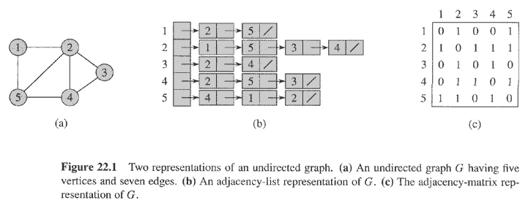
Representations of graphs (Examples)

Slide 17
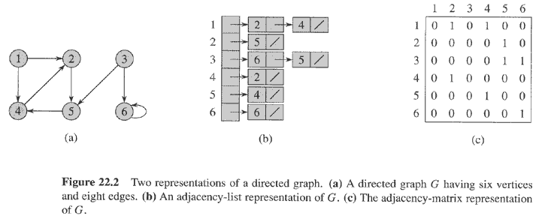
Representations of graphs (Examples)

Slide 18
Adjacency-list representation
Some questions.
  How to compute the degree of each vertex?
  What is the total length of all the adjacency-lists?
  How to determine whether a given edge is present in the graph or not?

Slide 19
Adjacency-list representation
sum of the lengths of all the adjacency lists is
  2| E | if G is an undirected graph
  | E | if G is a directed graph
Memory needed to store an adjacency-list representation of a graph is O(| V | + | E |)
Weighted graph can be represented by adjacency lists.

Slide 20
Adjacency-list representation (advantage vs disadvantage)
Advantage:
  when the graph is sparse, uses only O(| V | + | E |) memory.
Disadvantage:
  no quicker way to determine if a given edge (u, v) is present in the graph than searching v in the adjacency list Adj[u]. O(| V |)

Slide 21
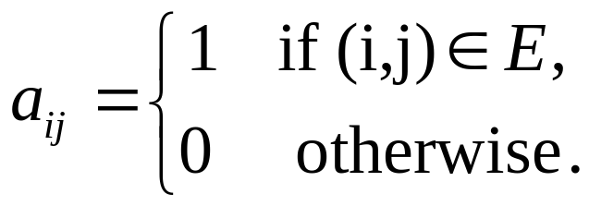
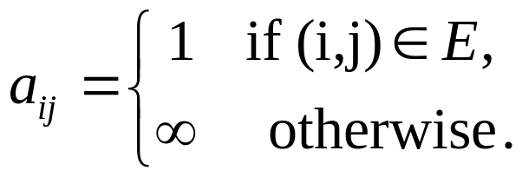
Adjacency-matrix representation
Consists of a | V | × | V | matrix A = (a_{ij}) such that
or
A is symmetric along the main diagonal for undirected graphs, that is, A^{T} = A.
For directed graph, generally, A^{T} ≠ A. Can you imagine what directed graph satisfies A^{T} = A?
Adjacency-matrix can be used to represent weighted graphs.

Slide 22
Representations of graphs (Examples)

Slide 23
Representations of graphs (Examples)

Slide 24
Properties of adjacency-matrix representation
Lemma1.3: Suppose that A is the adjacency-matrix representation of an undirected graph G, then the element A^{k}[i, j] of A^{k} = A⋅A⋅… ⋅A is the number of paths(通路) of length k that connect vertices i and j.
  Proof by induction on k.
    Basic step: k = 1, A¹ = A, A[i, j] is the number of paths of length 1 that connect vertices i and j.
    Hypothesis : A^{k}[i, j] is the number of paths of length k that connect vertices i and j.
    Inductive step: A^{k+1}=A ⋅ A^{k}, we have A^{k+1}[i, j] = Σ_{l∈V} A[i, l] ⋅ A^{k}[l, j]. For A[i, l] is the number of paths of length 1 that connect vertices i and l, A^{k}[l, k] is the number of paths of length k that connect vertices l and j. So, A[i, l] ⋅ A^{k}[l, j] is the number of paths of length k+1 that connect vertices i and j via l. Consider all vertices l, 1≤ l ≤ n, we get our conclusion.

Slide 25
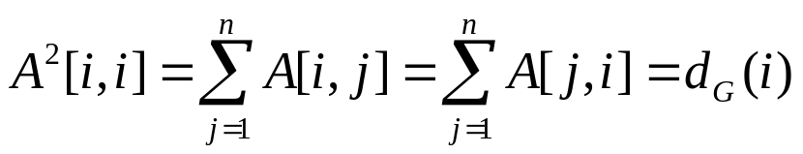
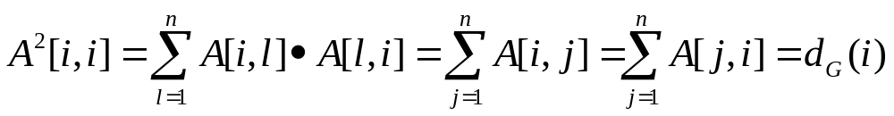
Properties of adjacency-matrix representation
Corollary 1.4
Proof: For symmetry of adjacency-matrix,
A[i, l]=A[l, i] = 0 or 1, so
1
2
A²[1, 1]: 2: (1, 2, 1), (1, 3, 1)
A²[2, 2]: 3: (2, 1, 2), (2, 3, 2), (2, 4, 2)
3
4

Slide 26
Adjacency-matrix representation (Advantage vs disadvantage)
Advantage:
  Easily or quickly to determine if an edge is in the graph or not. O(1)
Disadvantage:
  Uses more memory to store a graph. O(| V |²)

